Slide 1
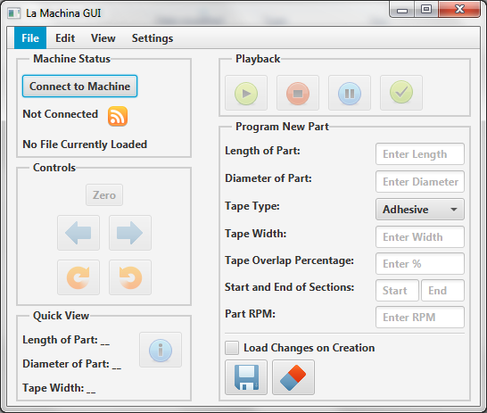
Systems - Graphical User Interface
Accepts user inputs to define part dimensions
Stores part profiles
Manual motion controls
Start – Stop – Pause
Programmed in Java

